Slide 1



SYNTAX ANALYSIS
BCSE307L_COMPILER DESIGN
Dr. B.V. Baiju,
SCOPE,Assistant Professor
VIT, Vellore

Slide 2
RECURSIVE DESCENT PARSING
Parsing methods
Parsing
Top down parsing
Bottom up parsing (Shift reduce)
Back tracking
Operator precedence
Parsing without backtracking (predictive parsing)
LR parsing
SLR
LL(1)
CLR
Recursive
descent
LALR

Slide 3
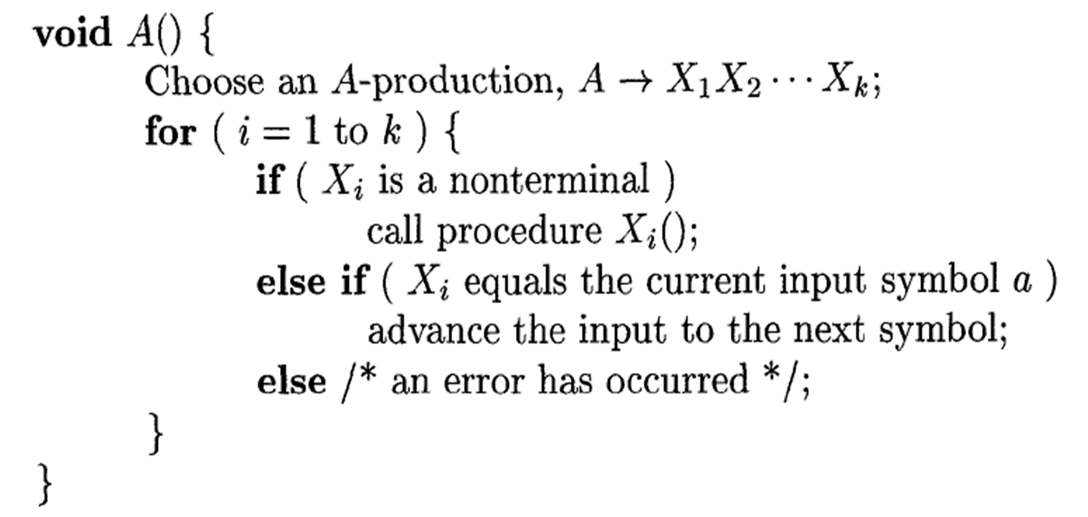
A top down parsing that executes a set of recursive procedure to process the input without backtracking is called recursive descent parser.
The term descent refers to the direction in which the parse tree is built.
It builds the parse tree from the root to the leaf.
Write a procedure for each non terminal in the grammar.
Consider RHS of any production rule as definition of the procedure.
As it reads expected input symbol, it advances pointer to next input position.

Slide 4
Consider the following grammar:
# Procedure to match a character and input new character
match(char t)
{
if (l == t) {
l = getchar();
}
else{
printf("Error");
}
}
main()
{
E();
if (l==’$’){
printf(“Parsing Successful”);
}
}
E -> iE^{I}
E^{I} -> +iE / ε
E and E’ are non-terminals and ‘+’, ‘i’ are characters.
Epsilon represents the end of the recursion
# Procedure for E
E()
{
# l is the lookahead
if (l == ‘i’)
{
match(‘i’);
E’();
}
}
# Procedure for E’
E’()
{
if (l == ‘+’)
{
match(‘+’)
match(‘i’)
E’();
}
else
return;
}

Slide 5
Example: Recursive Descent parsing
Procedure E
{
If lookahead=num
{
Match(num);
T();
}
Else
Error();
If lookahead=$
{
Declare success;
}
Else
Error();
}
Procedure T
{
If lookahead=’*’
{
Match(‘*’);
If lookahead=num
{
Match(num);
T();
}
Else
Error();
}
Else
NULL
}
Proceduce Match(token t)
{
If lookahead=t
lookahead=next_token;
Else
Error();
}
Procedure Error
{
Print(“Error”);
}
E→
T→
num
T
num
| 𝜖
*
T
3 | * | 4 | $
Success

Slide 6
Example: Recursive Descent parsing
Procedure E
{
If lookahead=num
{
Match(num);
T();
}
Else
Error();
If lookahead=$
{
Declare success;
}
Else
Error();
}
Procedure T
{
If lookahead=’*’
{
Match(‘*’);
If lookahead=num
{
Match(num);
T();
}
Else
Error();
}
Else
NULL
}
Proceduce Match(token t)
{
If lookahead=t
lookahead=next_token;
Else
Error();
}
Procedure Error
{
Print(“Error”);
}
E→
T→
num
T
num
| 𝜖
*
T
3 | * | 4 | $
Success
3 | 4 | * | $
Error

Slide 7
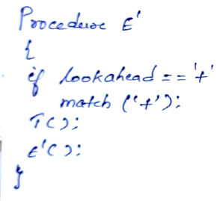
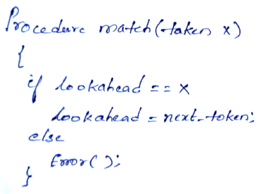
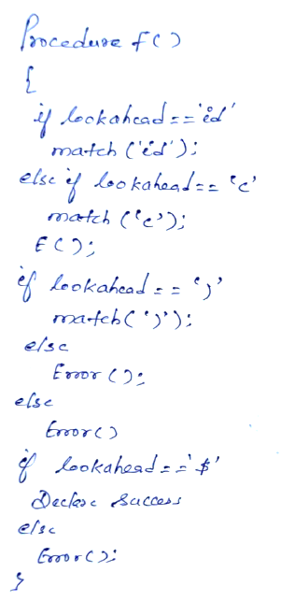
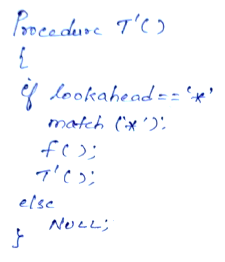
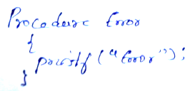
Example 2 : Write down the algorithm using Recursive procedures to implement the following Grammar
E → TE′
E′ → +TE′
T → FT′
T′ →∗ FT′|ε
F → (E)|id

Slide 8
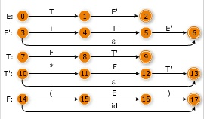
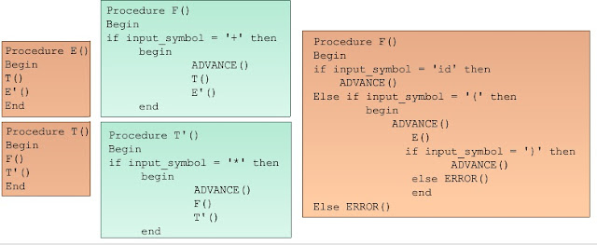
Transition diagrams
Code for parser

